Slide 1
CIS CONTROL 18: APPLICATION SOFTWARE SECURITY-I
APPLICATION SOFTWARE SECURITY

Slide 2
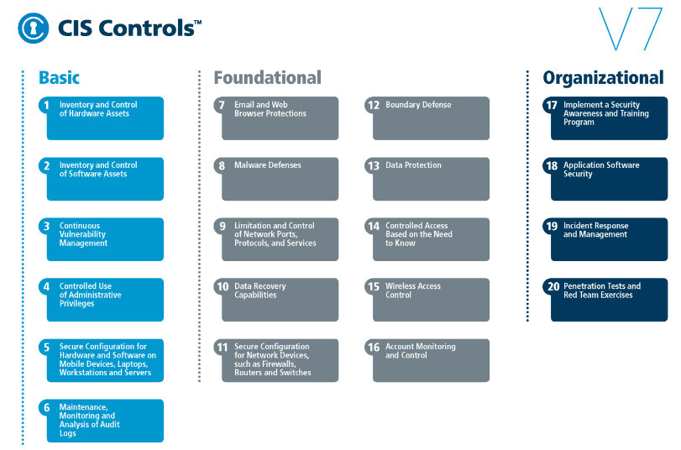
CIS CONTROL 18: APPLICATION SOFTWARE SECURITY-I
https://www.cisecurity.org/controls/

Slide 3
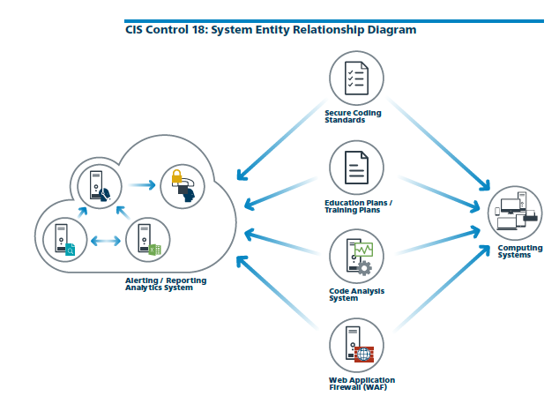
CIS CONTROL 18: APPLICATION SOFTWARE SECURITY-I
https://www.cisecurity.org/controls/

Slide 4
CIS CONTROL 18: APPLICATION SOFTWARE SECURITY-II
18.5: Use Only Standardized and Extensively Reviewed Encryption Algorithms
Use only standardized and extensively reviewed encryption algorithms.

Slide 5
CIS CONTROL 18: APPLICATION SOFTWARE SECURITY-II
18.6: Ensure Software Development Personnel are Trained in Secure Coding
Ensure that all software development personnel receive training in writing secure code for their specific development environment and responsibilities.

Slide 6
CIS CONTROL 18: APPLICATION SOFTWARE SECURITY-II
18.7: Apply Static and Dynamic Code Analysis Tools
Apply static and dynamic analysis tools to verify that secure coding practices are being adhered to for internally developed software.

Slide 7
CIS CONTROL 18: APPLICATION SOFTWARE SECURITY-II
18.8: Establish a Process to Accept and Address Reports of Software Vulnerabilities
Establish a process to accept and address reports of software vulnerabilities, including providing a means for external entities to contact your security group.
END

